Slide 1

William Stallings, Computer Organization and Architecture, 9th Edition
Chapter 6
External Memory
Notes:
Lecture slides prepared for “Computer Organization and Architecture”, 9/e, by William Stallings, Chapter 6 “External Memory”.
Adapted by Thân Văn Sử

Slide 2
Objectives
How are disks organized?
How to insure data stored in disks?
How to increase disk accessing?
After studying this chapter, you should be able to:
Understand the key properties of magnetic disks.
Understand the performance issues involved in magnetic disk access.
Explain the concept of RAID and describe the various levels.
Compare and contrast hard disk drives and solid disk drives.
Describe in general terms the operation of flash memory.
Understand the differences among the different optical disk storage media.
Present an overview of magnetic tape storage technology.

Slide 3
Contents
6.1 Magnetic Disk
6.2 Raid
6.3 Solid State Drives
6.4 Optical Memory
6.5 Magnetic Tape

Slide 4
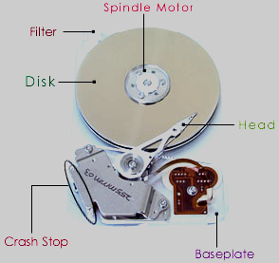
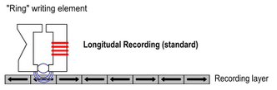

6.1- Magnetic Disk
A disk is a circular platter constructed of nonmagnetic material, called the substrate-chất nền, coated with a magnetizable material
Traditionally the substrate has been an aluminium or aluminium alloy (hợp kim nhôm) material
Recently glass substrates have been introduced
Benefits of the glass substrate:
Improvement in the uniformity of the magnetic film surface to increase disk reliability
A significant reduction in overall surface defects to help reduce read-write errors
Ability to support lower fly heights (cho phép mỏng hơn)
Better stiffness (cứng) to reduce disk dynamics
Greater ability to withstand(anti) shock and damage
(Wiki)
Notes:
A disk is a circular platter constructed of nonmagnetic material, called the substrate,
coated with a magnetizable material. Traditionally, the substrate has been an aluminum
or aluminum alloy material. More recently, glass substrates have been introduced.
The glass substrate has a number of benefits, including the following:
• Improvement in the uniformity of the magnetic film surface to increase disk
reliability
• A significant reduction in overall surface defects to help reduce read-write errors
• Ability to support lower fly heights (described subsequently)
• Better stiffness to reduce disk dynamics
• Greater ability to withstand shock and damage

Slide 5
Magnetic Read and Write Mechanisms
Data are recorded on and later retrieved from the disk via a conducting coil named the head
In many systems there are two heads, a read head and a write head
During a read or write operation the head is stationary while the platter rotates beneath it
Electric pulses are sent to the write head and the resulting magnetic patterns are recorded on the surface below, with different patterns for positive and negative currents
The write mechanism exploits the fact that electricity flowing through a coil produces a magnetic field
An electric current in the wire induces a magnetic field across the gap, which in turn magnetizes a small area of the recording medium
The write head itself is made of easily magnetizable material and is in the shape of a rectangular doughnut with a gap along one side and a few turns of conducting wire along the opposite side
Reversing the direction of the current reverses the direction of the magnetization on the recording medium
Notes:
Data are recorded on and later retrieved from the disk via a conducting coil named
the head; in many systems, there are two heads, a read head and a write head. During
a read or write operation, the head is stationary while the platter rotates beneath it.
The write mechanism exploits the fact that electricity flowing through a coil
produces a magnetic field. Electric pulses are sent to the write head, and the resulting
magnetic patterns are recorded on the surface below, with different patterns for
positive and negative currents. The write head itself is made of easily magnetizable
material and is in the shape of a rectangular doughnut with a gap along one side and
a few turns of conducting wire along the opposite side (Figure 6.1). An electric current
in the wire induces a magnetic field across the gap, which in turn magnetizes a
small area of the recording medium. Reversing the direction of the current reverses
the direction of the magnetization on the recording medium.
The traditional read mechanism exploits the fact that a magnetic field moving
relative to a coil produces an electrical current in the coil. When the surface of the
disk passes under the head, it generates a current of the same polarity as the one
already recorded. The structure of the head for reading is in this case essentially
the same as for writing and therefore the same head can be used for both. Such
single heads are used in floppy disk systems and in older rigid disk systems.
Contemporary rigid disk systems use a different read mechanism, requiring
a separate read head, positioned for convenience close to the write head. The read
head consists of a partially shielded magnetoresistive (MR) sensor. The MR material
has an electrical resistance that depends on the direction of the magnetization of
the medium moving under it. By passing a current through the MR sensor, resistance
changes are detected as voltage signals. The MR design allows higher-frequency
operation, which equates to greater storage densities and operating speeds.

Slide 6
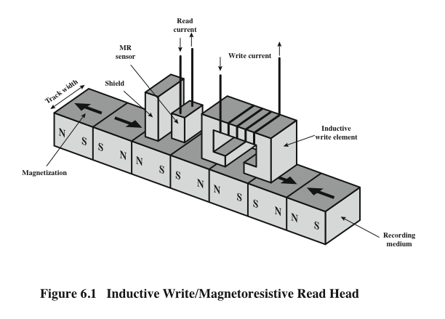
Inductive Write/Magnetoresistive Read Head
Inductive Write: Ghi cảm ứng điện từ
Magneto-resistive Read: đọc từ điện
N: North, S: South
Notes:
Shield che chắn từ trường để chống nhiễu
Figure 6.1. Inductive Write/Magnetoresistive Read Head

Slide 7
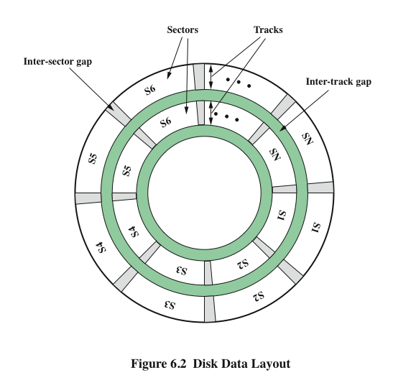
Disk Data Layout
Notes:
The head is a relatively small device capable of reading from or writing to a portion
of the platter rotating beneath it. This gives rise to the organization of data on the
platter in a concentric set of rings, called tracks. Each track is the same width as the
head. There are thousands of tracks per surface.
Figure 6.2 depicts this data layout. Adjacent tracks are separated by gaps. This
prevents, or at least minimizes, errors due to misalignment of the head or simply
interference of magnetic fields.
Data are transferred to and from the disk in sectors (Figure 6.2). There are
typically hundreds of sectors per track, and these may be of either fixed or variable
length. In most contemporary systems, fixed-length sectors are used, with 512 bytes
being the nearly universal sector size. To avoid imposing unreasonable precision
requirements on the system, adjacent sectors are separated by intratrack (intersector)
gaps.

Slide 8
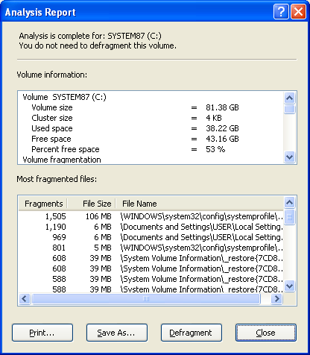
Disk Allocation Unit in Windows: Cluster
Notes:
A bit near the center of a rotating disk travels past a fixed point (such as a read–
write head) slower than a bit on the outside. Therefore, some way must be found
to compensate for the variation in speed so that the head can read all the bits at the
same rate. This can be done by increasing the spacing between bits of information
recorded in segments of the disk. The information can then be scanned at the same
rate by rotating the disk at a fixed speed, known as the constant angular velocity
(CAV). Figure 6.3a shows the layout of a disk using CAV. The disk is divided into
a number of pie-shaped sectors and into a series of concentric tracks. The advantage
of using CAV is that individual blocks of data can be directly addressed by
track and sector. To move the head from its current location to a specific address, it
only takes a short movement of the head to a specific track and a short wait for the
proper sector to spin under the head. The disadvantage of CAV is that the amount
of data that can be stored on the long outer tracks is the only same as what can be
stored on the short inner tracks.
Because the density, in bits per linear inch, increases in moving from the outermost
track to the innermost track, disk storage capacity in a straightforward CAV
system is limited by the maximum recording density that can be achieved on the
innermost track. To increase density, modern hard disk systems use a technique
known as multiple zone recording, in which the surface is divided into a number
of concentric zones (16 is typical). Within a zone, the number of bits per track is
constant. Zones farther from the center contain more bits (more sectors) than zones
closer to the center. This allows for greater overall storage capacity at the expense
of somewhat more complex circuitry. As the disk head moves from one zone to
another, the length (along the track) of individual bits changes, causing a change
in the timing for reads and writes. Figure 6.3b suggests the nature of multiple zone
recording; in this illustration, each zone is only a single track wide.

Slide 9
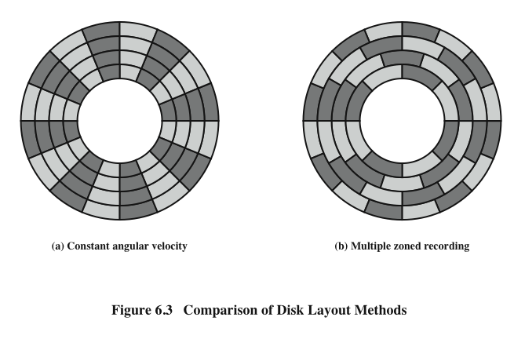
Disk Layout Methods Diagram
Characteristics: Read by yourself
Notes:
A bit near the center of a rotating disk travels past a fixed point (such as a read–
write head) slower than a bit on the outside. Therefore, some way must be found
to compensate for the variation in speed so that the head can read all the bits at the
same rate. This can be done by increasing the spacing between bits of information
recorded in segments of the disk. The information can then be scanned at the same
rate by rotating the disk at a fixed speed, known as the constant angular velocity
(CAV). Figure 6.3a shows the layout of a disk using CAV. The disk is divided into
a number of pie-shaped sectors and into a series of concentric tracks. The advantage
of using CAV is that individual blocks of data can be directly addressed by
track and sector. To move the head from its current location to a specific address, it
only takes a short movement of the head to a specific track and a short wait for the
proper sector to spin under the head. The disadvantage of CAV is that the amount
of data that can be stored on the long outer tracks is the only same as what can be
stored on the short inner tracks.
Because the density, in bits per linear inch, increases in moving from the outermost
track to the innermost track, disk storage capacity in a straightforward CAV
system is limited by the maximum recording density that can be achieved on the
innermost track. To increase density, modern hard disk systems use a technique
known as multiple zone recording, in which the surface is divided into a number
of concentric zones (16 is typical). Within a zone, the number of bits per track is
constant. Zones farther from the center contain more bits (more sectors) than zones
closer to the center. This allows for greater overall storage capacity at the expense
of somewhat more complex circuitry. As the disk head moves from one zone to
another, the length (along the track) of individual bits changes, causing a change
in the timing for reads and writes. Figure 6.3b suggests the nature of multiple zone
recording; in this illustration, each zone is only a single track wide.

Slide 10
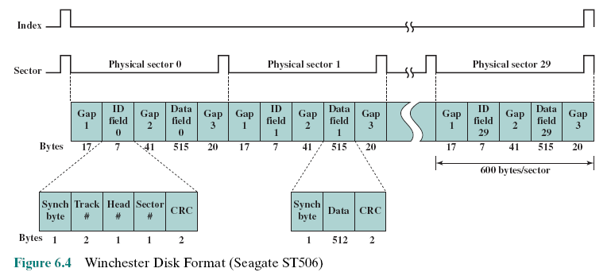
Winchester Disk Format Seagate ST506
CRC- cyclic redundancy check – Data for error checking
Synch. Byte: Byte for identify the beginning of data
Notes:
Some means is needed to locate sector positions within a track. Clearly, there
must be some starting point on the track and a way of identifying the start and end
of each sector. These requirements are handled by means of control data recorded
on the disk. Thus, the disk is formatted with some extra data used only by the disk
drive and not accessible to the user.
An example of disk formatting is shown in Figure 6.4. In this case, each track
contains 30 fixed-length sectors of 600 bytes each. Each sector holds 512 bytes of
data plus control information useful to the disk controller. The ID field is a unique
identifier or address used to locate a particular sector. The SYNCH byte is a special
bit pattern that delimits the beginning of the field. The track number identifies a
track on a surface. The head number identifies a head, because this disk has multiple
surfaces (explained presently). The ID and data fields each contain an error detecting
code.

Slide 11
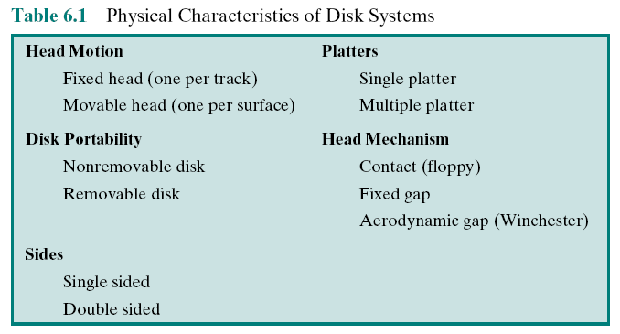
Table 6.1: Physical Characteristics of Disk Systems
Notes:
Table 6.1 lists the major characteristics that differentiate among the various types of magnetic disks.

Slide 12

Characteristics
Fixed-head disk
One read-write head per track
Heads are mounted on a fixed ridged arm that extends across all tracks
Movable-head disk
One read-write head
Head is mounted on an arm
The arm can be extended or retracted
Removable disk
Can be removed and replaced with another disk
Advantages:
Unlimited amounts of data are available with a limited number of disk systems
A disk may be moved from one computer system to another
Floppy disks and ZIP cartridge disks are examples of removable disks
Non-removable disk
Permanently mounted in the disk drive
The hard disk in a personal computer is a non-removable disk
Double sided disk
Magnetizable coating is applied to both sides of the platter
Notes:
First, the head may either be fixed or movable with respect to
the radial direction of the platter. In a fixed-head disk, there is one read-write
head per track. All of the heads are mounted on a rigid arm that extends across
all tracks; such systems are rare today. In a movable-head disk, there is only one
read-write head. Again, the head is mounted on an arm. Because the head must
be able to be positioned above any track, the arm can be extended or retracted for
this purpose.
The disk itself is mounted in a disk drive, which consists of the arm, a spindle
that rotates the disk, and the electronics needed for input and output of binary data.
A non-removable disk is permanently mounted in the disk drive; the hard disk in
a personal computer is a non-removable disk. A removable disk can be removed
and replaced with another disk. The advantage of the latter type is that unlimited
amounts of data are available with a limited number of disk systems. Furthermore,
such a disk may be moved from one computer system to another. Floppy disks and
ZIP cartridge disks are examples of removable disks.
For most disks, the magnetizable coating is applied to both sides of the platter,
which is then referred to as double sided. Some less expensive disk systems use
single-sided disks.

Slide 13
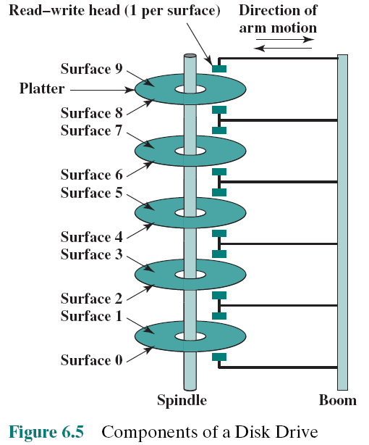
Multiple Platters
Notes:
Some disk drives accommodate multiple platters stacked vertically a fraction
of an inch apart. Multiple arms are provided (Figure 6.5). Multiple–platter disks
employ a movable head, with one read-write head per platter surface. All of the
heads are mechanically fixed so that all are at the same distance from the center of
the disk and move together. Thus, at any time, all of the heads are positioned over
tracks that are of equal distance from the center of the disk.

Slide 14
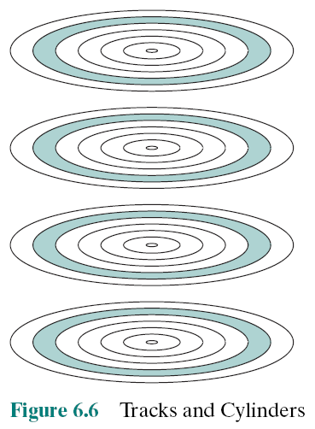

Tracks
Cylinders
Notes:
Cylinder: tập hợp các track trên các mặt đĩa (nhìn từ trên nhìn xuống)
The set of all the tracks
in the same relative position on the platter is referred to as a cylinder.
For example, all of the shaded tracks in Figure 6.6 are part of one cylinder.

Slide 15
Disk Classification
The head mechanism provides a classification of disks into three types
The head must generate or sense an electromagnetic field of sufficient magnitude to write and read properly
The narrower the head, the closer it must be to the platter surface to function
A narrower head means narrower tracks and therefore greater data density
The closer the head is to the disk the greater the risk of error from impurities or imperfections
Winchester Heads
Used in sealed drive assemblies that are almost free of contaminants (chất ô nhiễm)
Designed to operate closer to the disk’s surface than conventional rigid (rời) disk heads, thus allowing greater data density
Is actually an aerodynamic foil (lá) that rests lightly on the platter’s surface when the disk is motionless
The air pressure generated by a spinning disk is enough to make the foil rise above the surface
Notes:
Finally, the head mechanism provides a classification of disks into three types.
Traditionally, the read-write head has been positioned a fixed distance above the
platter, allowing an air gap. At the other extreme is a head mechanism that actually
comes into physical contact with the medium during a read or write operation. This
mechanism is used with the floppy disk, which is a small, flexible platter and the
least expensive type of disk.
To understand the third type of disk, we need to comment on the relationship
between data density and the size of the air gap. The head must generate or sense an
electromagnetic field of sufficient magnitude to write and read properly. The narrower
the head is, the closer it must be to the platter surface to function. A narrower
head means narrower tracks and therefore greater data density, which is desirable.
However, the closer the head is to the disk, the greater the risk of error from impurities
or imperfections. To push the technology further, the Winchester disk was
developed. Winchester heads are used in sealed drive assemblies that are almost
free of contaminants. They are designed to operate closer to the disk’s surface than
conventional rigid disk heads, thus allowing greater data density. The head is actually
an aerodynamic foil that rests lightly on the platter’s surface when the disk is
motionless. The air pressure generated by a spinning disk is enough to make the foil
rise above the surface. The resulting noncontact system can be engineered to use
narrower heads that operate closer to the platter’s surface than conventional rigid
disk heads.

Slide 16
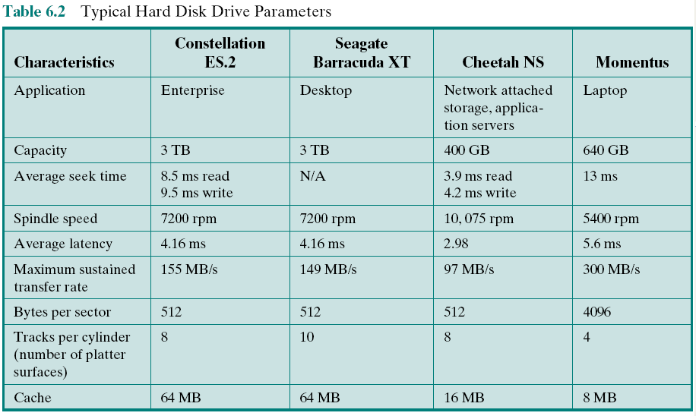
Typical Hard Disk Parameters
Notes:
Table 6.2 gives disk parameters for typical contemporary high-performance
disks.

Slide 17
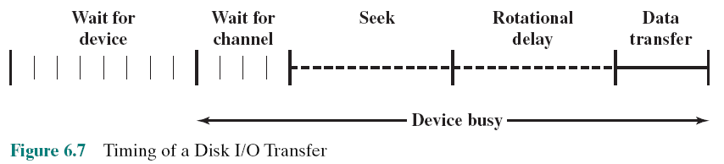
Timing of Disk I/O Transfer
The actual details of disk I/O operation depend on the computer system, the operating
system, and the nature of the I/O channel and disk controller hardware.

Slide 18

Disk Performance Parameters
When the disk drive is operating the disk is rotating at constant speed
To read or write the head must be positioned at the desired track and at the beginning of the desired sector on the track
Track selection involves moving the head in a movable-head system or electronically selecting one head on a fixed-head system
Once the track is selected, the disk controller waits until the appropriate sector rotates to line up with the head
Seek time
On a movable–head system, the time it takes to position the head at the track
Notes:
When the disk drive is operating, the disk is rotating at constant speed. To
read or write, the head must be positioned at the desired track and at the beginning
of the desired sector on that track. Track selection involves moving the head in a
movable-head system or electronically selecting one head on a fixed-head system.
On a movable-head system, the time it takes to position the head at the track is
known as seek time. In either case, once the track is selected, the disk controller
waits until the appropriate sector rotates to line up with the head. The time it takes
for the beginning of the sector to reach the head is known as rotational delay, or
rotational latency. The sum of the seek time, if any, and the rotational delay equals
the access time, which is the time it takes to get into position to read or write. Once
the head is in position, the read or write operation is then performed as the sector
moves under the head; this is the data transfer portion of the operation; the time
required for the transfer is the transfer time.
It is clear that the order in which sectors are read from the disk has a tremendous
effect on I/O performance. In the case of file access in which multiple
sectors are read or written, we have some control over the way in which sectors
of data are deployed. However, even in the case of a file access, in a multiprogramming
environment, there will be I/O requests competing for the same disk.
Thus, it is worthwhile to examine ways in which the performance of disk I/O
can be improved over that achieved with purely random access to the disk. This
leads to a consideration of disk scheduling algorithms, which is the province of
the operating system and beyond the scope of this book (see [STAL12] for a
discussion).

Slide 19
Disk Performance Parameters
Rotational delay (rotational latency)
The time it takes for the beginning of the sector to reach the head
Access time
The sum of the seek time and the rotational delay
The time it takes to get into position to read or write
Transfer time
Once the head is in position, the read or write operation is then performed as the sector moves under the head
This is the data transfer portion of the operation
Notes:
When the disk drive is operating, the disk is rotating at constant speed. To
read or write, the head must be positioned at the desired track and at the beginning
of the desired sector on that track. Track selection involves moving the head in a
movable-head system or electronically selecting one head on a fixed-head system.
On a movable-head system, the time it takes to position the head at the track is
known as seek time. In either case, once the track is selected, the disk controller
waits until the appropriate sector rotates to line up with the head. The time it takes
for the beginning of the sector to reach the head is known as rotational delay, or
rotational latency. The sum of the seek time, if any, and the rotational delay equals
the access time, which is the time it takes to get into position to read or write. Once
the head is in position, the read or write operation is then performed as the sector
moves under the head; this is the data transfer portion of the operation; the time
required for the transfer is the transfer time.
It is clear that the order in which sectors are read from the disk has a tremendous
effect on I/O performance. In the case of file access in which multiple
sectors are read or written, we have some control over the way in which sectors
of data are deployed. However, even in the case of a file access, in a multiprogramming
environment, there will be I/O requests competing for the same disk.
Thus, it is worthwhile to examine ways in which the performance of disk I/O
can be improved over that achieved with purely random access to the disk. This
leads to a consideration of disk scheduling algorithms, which is the province of
the operating system and beyond the scope of this book (see [STAL12] for a
discussion).

Slide 20
Exercise
Một ổ cứng có tốc độ quay 5400RPM, seek time trung bình 8.5ms, 512 sectors/track. Hỏi thời gian trung bình để đọc 1 sector:
Thời gian quay 1 vòng = 1*60*1000ms/5400 = 11.1 ms
T1 = seek time trung bình = 8.5ms
T2= average rotational delay = thời gian quay ½ vòng tròn
= 11.1 ms/2 = 5.5 ms
T3= transfer time= thời gian quay 1/512 vòng tròn
= 11.1 ms/512 = 0.02 ms
T= T1 + T2 + T3 = 14.02 ms
Check the result above

Slide 21
6.2- RAID
Consists of 7 levels
Levels do not imply a hierarchical relationship but designate different design architectures that share three common characteristics:
Set of physical disk drives viewed by the operating system as a single logical drive
Data are distributed across the physical drives of an array in a scheme known as striping
Redundant disk capacity is used to store parity information, which guarantees data recoverability in case of a disk failure
Redundant Array of Independent Disks
Redundant Array of Inexpensive Disks
Long life
Availability
Performance 🡪 Parallel accessing
Reliability 🡪 Backup, checking
🡺 Multi-disk design
Notes:
With the use of multiple disks, there is a wide variety of ways in which the
data can be organized and in which redundancy can be added to improve reliability.
This could make it difficult to develop database schemes that are usable
on a number of platforms and operating systems. Fortunately, industry has
agreed on a standardized scheme for multiple-disk database design, known as
RAID (Redundant Array of Independent Disks). The RAID scheme consists
of seven levels, zero through six. These levels do not imply a hierarchical relationship
but designate different design architectures that share three common
characteristics:
1. RAID is a set of physical disk drives viewed by the operating system as a single
logical drive.
2. Data are distributed across the physical drives of an array in a scheme known
as striping, described subsequently.
3. Redundant disk capacity is used to store parity information, which guarantees
data recoverability in case of a disk failure.
The details of the second and third characteristics differ for the different RAID
levels. RAID 0 and RAID 1 do not support the third characteristic.

Slide 22
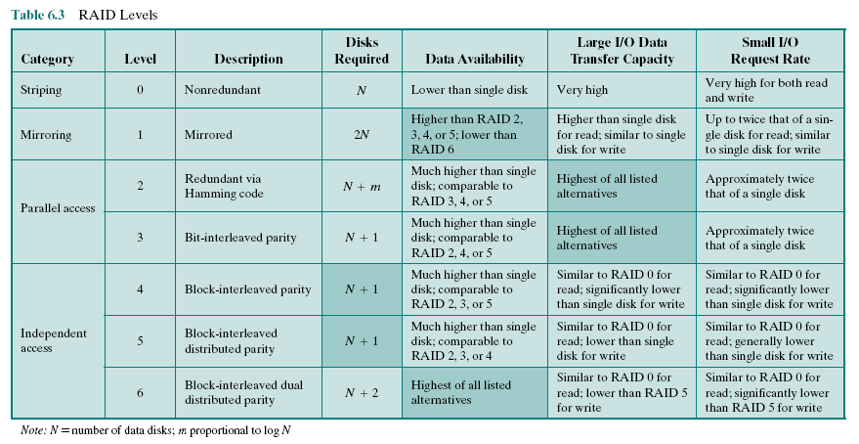
Table 6.3 RAID Levels
Notes:
We now examine each of the RAID levels. Table 6.3 provides a rough guide
to the seven levels. In the table, I/O performance is shown both in terms of data
transfer capacity, or ability to move data, and I/O request rate, or ability to satisfy
I/O requests, since these RAID levels inherently perform differently relative
to these two metrics. Each RAID level’s strong point is highlighted by darker
shading.

Slide 23
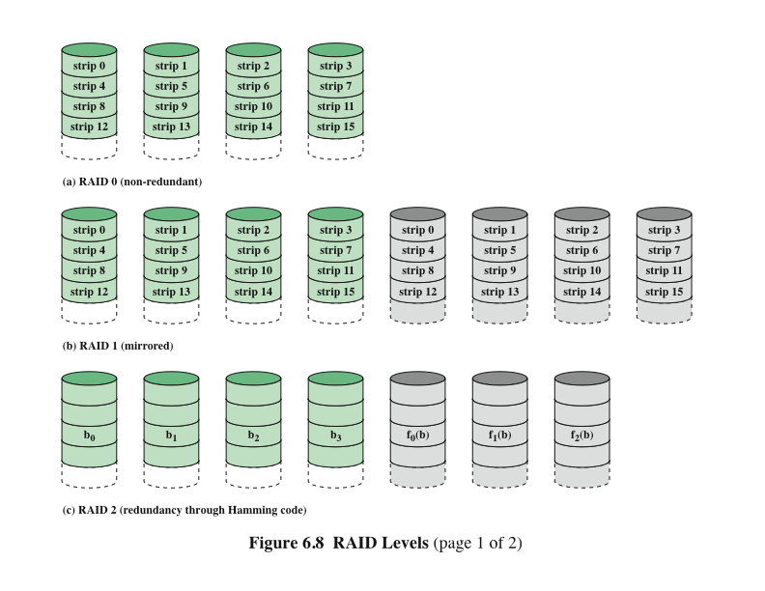
RAID Levels 0, 1, 2
Notes:
Figure 6.8 illustrates the use of the seven RAID schemes to support a
data capacity requiring four disks with no redundancy. The figures highlight the
layout of user data and redundant data and indicates the relative storage requirements
of the various levels. We refer to these figures throughout the following
discussion.

Slide 24
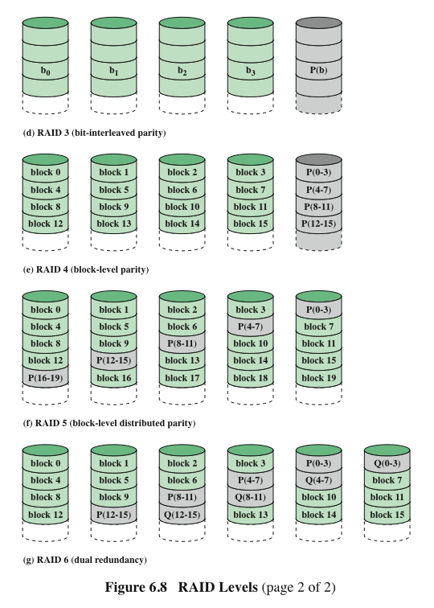
RAID Levels 3, 4, 5, 6
Notes:
Figure 6.8 continued.

Slide 25
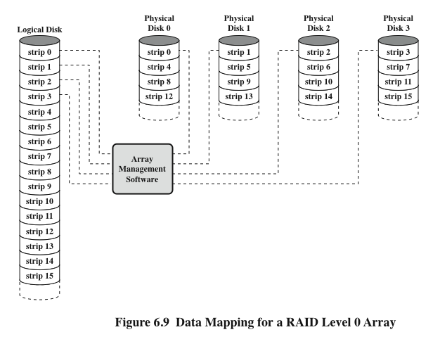
Data Mapping for a RAID Level 0 Array
Notes:
But RAID 0, as with all of the RAID levels, goes further than simply distributing
the data across a disk array: The data are striped across the available disks. This is
best understood by considering Figure 6.9. All of the user and system data are viewed
as being stored on a logical disk. The logical disk is divided into strips; these strips
may be physical blocks, sectors, or some other unit. The strips are mapped round
robin to consecutive physical disks in the RAID array. A set of logically consecutive
strips that maps exactly one strip to each array member is referred to as a stripe.
In an n-disk array, the first n logical strips are physically stored as the first strip on
each of the n disks, forming the first stripe; the second n strips are distributed as the
second strips on each disk; and so on. The advantage of this layout is that if a single
I/O request consists of multiple logically contiguous strips, then up to n strips for
that request can be handled in parallel, greatly reducing the I/O transfer time.
Figure 6.9 indicates the use of array management software to map between
logical and physical disk space. This software may execute either in the disk subsystem
or in a host computer.

Slide 26
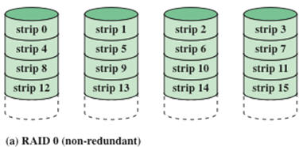
RAID Level 0
Addresses the issues of request patterns of the host systemand layout of the data
Impact of redundancy does not interfere with analysis
RAID 0 for High Data Transfer Capacity
RAID 0 for High I/O Request Rate
For applications to experience a high transfer rate two requirements must be met:
A high transfer capacity must exist along the entire path between host memory and the individual disk drives
The application must make I/O requests that drive the disk array efficiently
For an individual I/O request for a small amount of data the I/O time is dominated by the seek time and rotational latency
A disk array can provide high I/O execution rates by balancing the I/O load across multiple disks
If the strip size is relatively large multiple waiting I/O requests can be handled in parallel, reducing the queuing time for each request
Notes:
The performance of any of the
RAID levels depends critically on the request patterns of the host system and on
the layout of the data. These issues can be most clearly addressed in RAID 0, where
the impact of redundancy does not interfere with the analysis. First, let us consider
the use of RAID 0 to achieve a high data transfer rate. For applications to experience
a high transfer rate, two requirements must be met. First, a high transfer capacity
must exist along the entire path between host memory and the individual disk drives.
This includes internal controller buses, host system I/O buses, I/O adapters, and host
memory buses.
The second requirement is that the application must make I/O requests that
drive the disk array efficiently. This requirement is met if the typical request is for
large amounts of logically contiguous data, compared to the size of a strip. In this
case, a single I/O request involves the parallel transfer of data from multiple disks,
increasing the effective transfer rate compared to a single-disk transfer.
In a transaction-oriented environment, the user is typically more concerned with
response time than with transfer rate. For
an individual I/O request for a small amount of data, the I/O time is dominated by the
motion of the disk heads (seek time) and the movement of the disk (rotational latency).
In a transaction environment, there may be hundreds of I/O requests per second.
A disk array can provide high I/O execution rates by balancing the I/O load
across multiple disks. Effective load balancing is achieved only if there are typically
multiple I/O requests outstanding. This, in turn, implies that there are multiple independent
applications or a single transaction-oriented application that is capable of
multiple asynchronous I/O requests. The performance will also be influenced by the
strip size. If the strip size is relatively large, so that a single I/O request only involves
a single disk access, then multiple waiting I/O requests can be handled in parallel,
reducing the queuing time for each request.

Slide 27
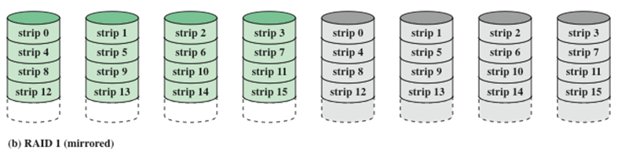
RAID Level 1
Characteristics
Differs from RAID levels 2 through 6 in the way in which redundancy is achieved
Redundancy is achieved by the simple expedient of duplicating all the data
Data striping is used but each logical strip is mapped to two separate physical disks so that every disk in the array has a mirror disk that contains the same data
RAID 1 can also be implemented without data striping, although this is less common
Positive Aspects
A read request can be serviced by either of the two disks that contains the requested data
There is no “write penalty”
Recovery from a failure is simple, when a drive fails the data can be accessed from the second drive
Provides real-time copy of all data
Can achieve high I/O request rates if the bulk of the requests are reads
Principal disadvantage is the cost
Notes:
RAID 1 differs from RAID levels 2 through 6 in the way in which redundancy is
achieved. In these other RAID schemes, some form of parity calculation is used to
introduce redundancy, whereas in RAID 1, redundancy is achieved by the simple
expedient of duplicating all the data. As Figure 6.8b shows, data striping is used, as
in RAID 0. But in this case, each logical strip is mapped to two separate physical
disks so that every disk in the array has a mirror disk that contains the same data.
RAID 1 can also be implemented without data striping, though this is less common.
There are a number of positive aspects to the RAID 1 organization:
1. A read request can be serviced by either of the two disks that contains the requested
data, whichever one involves the minimum seek time plus rotational
latency.
2. A write request requires that both corresponding strips be updated, but this
can be done in parallel. Thus, the write performance is dictated by the slower
of the two writes (i.e., the one that involves the larger seek time plus rotational
latency). However, there is no “write penalty” with RAID 1. RAID levels
2 through 6 involve the use of parity bits. Therefore, when a single strip is
updated, the array management software must first compute and update the
parity bits as well as updating the actual strip in question.
3. Recovery from a failure is simple. When a drive fails, the data may still be
accessed from the second drive.
The principal disadvantage of RAID 1 is the cost; it requires twice the disk
space of the logical disk that it supports. Because of that, a RAID 1 configuration
is likely to be limited to drives that store system software and data and other highly
critical files. In these cases, RAID 1 provides real-time copy of all data so that in the
event of a disk failure, all of the critical data are still immediately available.
In a transaction-oriented environment, RAID 1 can achieve high I/O request
rates if the bulk of the requests are reads. In this situation, the performance of RAID 1
can approach double of that of RAID 0. However, if a substantial fraction of the I/O
requests are write requests, then there may be no significant performance gain over
RAID 0. RAID 1 may also provide improved performance over RAID 0 for data
transfer intensive applications with a high percentage of reads. Improvement occurs
if the application can split each read request so that both disk members participate.

Slide 28
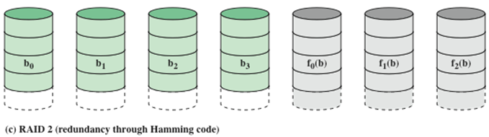
RAID Level 2
Characteristics
Performance
Makes use of a parallel access technique
In a parallel access array all member disks participate in the execution of every I/O request
Spindles of the individual drives are synchronized so that each disk head is in the same position on each disk at any given time
Data striping is used
Strips are very small, often as small as a single byte or word
An error-correcting code is calculated across corresponding bits on each data disk and the bits of the code are stored in the corresponding bit positions on multiple parity disks
Typically a Hamming code is used, which is able to correct single-bit errors and detect double-bit errors
The number of redundant disks is proportional to the log of the number of data disks
Would only be an effective choice in an environment in which many disk errors occur
Notes:
RAID levels 2 and 3 make use of a parallel access technique. In a parallel access
array, all member disks participate in the execution of every I/O request. Typically,
the spindles of the individual drives are synchronized so that each disk head is in the
same position on each disk at any given time.
As in the other RAID schemes, data striping is used. In the case of RAID 2
and 3, the strips are very small, often as small as a single byte or word. With RAID 2,
an error-correcting code is calculated across corresponding bits on each data disk,
and the bits of the code are stored in the corresponding bit positions on multiple
parity disks. Typically, a Hamming code is used, which is able to correct single-bit
errors and detect double-bit errors.
Although RAID 2 requires fewer disks than RAID 1, it is still rather costly.
The number of redundant disks is proportional to the log of the number of data
disks. On a single read, all disks are simultaneously accessed. The requested data
and the associated error-correcting code are delivered to the array controller. If
there is a single-bit error, the controller can recognize and correct the error instantly,
so that the read access time is not slowed. On a single write, all data disks and parity
disks must be accessed for the write operation.
RAID 2 would only be an effective choice in an environment in which many
disk errors occur. Given the high reliability of individual disks and disk drives,
RAID 2 is overkill and is not implemented.

Slide 29
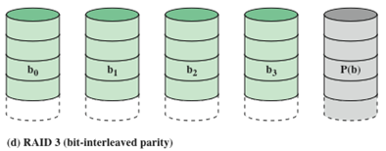
RAID Level 3
Performance
Redundancy
In the event of a drive failure, the parity drive is accessed and data is reconstructed from the remaining devices
Once the failed drive is replaced, the missing data can be restored on the new drive and operation resumed
In the event of a disk failure, all of the data are still available in what is referred to as reduced mode
Return to full operation requires that the failed disk be replaced and the entire contents of the failed disk be regenerated on the new disk
In a transaction-oriented environment performance suffers
Requires only a single redundant disk, no matter how large the disk array
Employs parallel access, with data distributed in small strips
Instead of an error correcting code, a simple parity bit is computed for the set of individual bits in the same position on all of the data disks
Can achieve very high data transfer rates
Notes:
RAID 3 is organized in a similar fashion to RAID 2. The difference is that RAID
3 requires only a single redundant disk, no matter how large the disk array. RAID
3 employs parallel access, with data distributed in small strips. Instead of an error correcting
code, a simple parity bit is computed for the set of individual bits in the
same position on all of the data disks.
In the event of a drive failure, the parity drive is accessed and data
is reconstructed from the remaining devices. Once the failed drive is replaced, the
missing data can be restored on the new drive and operation resumed.
In the event of a disk failure, all of the data are still available in what is referred
to as reduced mode. In this mode, for reads, the missing data are regenerated on the
fly using the exclusive-OR calculation. When data are written to a reduced RAID 3
array, consistency of the parity must be maintained for later regeneration. Return to
full operation requires that the failed disk be replaced and the entire contents of the
failed disk be regenerated on the new disk.
Because data are striped in very small strips, RAID 3 can achieve
very high data transfer rates. Any I/O request will involve the parallel transfer of
data from all of the data disks. For large transfers, the performance improvement is
especially noticeable. On the other hand, only one I/O request can be executed at a
time. Thus, in a transaction-oriented environment, performance suffers.

Slide 30
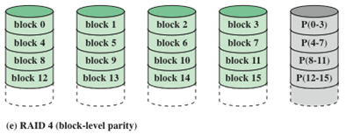
RAID Level 4
Characteristics
Makes use of an independent access technique
In an independent access array, each member disk operates independently so that separate I/O requests can be satisfied in parallel
Data striping is used
Strips are relatively large
To calculate the new parity the array management software must read the old user strip and the old parity strip
Performance
Involves a write penalty when an I/O write request of small size is performed
Each time a write occurs the array management software must update the user data the corresponding parity bits
Thus each strip write involves two reads and two writes
Notes:
RAID levels 4 through 6 make use of an independent access technique. In an independent
access array, each member disk operates independently, so that separate
I/O requests can be satisfied in parallel. Because of this, independent access arrays
are more suitable for applications that require high I/O request rates and are relatively
less suited for applications that require high data transfer rates.
As in the other RAID schemes, data striping is used. In the case of RAID
4 through 6, the strips are relatively large. With RAID 4, a bit-by-bit parity strip
is calculated across corresponding strips on each data disk, and the parity bits are
stored in the corresponding strip on the parity disk.
RAID 4 involves a write penalty when an I/O write request of small size is performed.
Each time that a write occurs, the array management software must update
not only the user data but also the corresponding parity bits.
To calculate the new parity, the array management software must read the old
user strip and the old parity strip. Then it can update these two strips with the new
data and the newly calculated parity. Thus, each strip write involves two reads and
two writes.
In the case of a larger size I/O write that involves strips on all disk drives, parity
is easily computed by calculation using only the new data bits. Thus, the parity drive
can be updated in parallel with the data drives and there are no extra reads or writes.
In any case, every write operation must involve the parity disk, which therefore
can become a bottleneck.

Slide 31
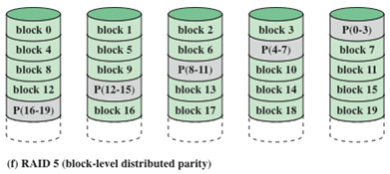
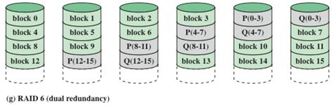
RAID Level 5
RAID Level 6
Characteristics
Characteristics
Organized in a similar fashion to RAID 4
Difference is distribution of the parity strips across all disks
A typical allocation is a round-robin scheme
The distribution of parity strips across all drives avoids the potential I/O bottleneck found in RAID 4
Two different parity calculations are carried out and stored in separate blocks on different disks
Advantage is that it provides extremely high data availability
Three disks would have to fail within the mean time to repair (MTTR) interval to cause data to be lost (usually expressed in hours)
Incurs (bears) a substantial write penalty because each write affects two parity blocks
Notes:
RAID 5 is organized in a similar fashion to RAID 4. The difference is that RAID
5 distributes the parity strips across all disks. A typical allocation is a round-robin
scheme, as illustrated in Figure 6.8f. For an n-disk array, the parity strip is on a
different disk for the first n stripes, and the pattern then repeats.
The distribution of parity strips across all drives avoids the potential I/O
bottle-neck found in RAID 4.
RAID 6 was introduced in a subsequent paper by the Berkeley researchers
[KATZ89]. In the RAID 6 scheme, two different parity calculations are carried out
and stored in separate blocks on different disks. Thus, a RAID 6 array whose user
data require N disks consists of N + 2 disks.
Figure 6.8g illustrates the scheme. P and Q are two different data check algorithms.
One of the two is the exclusive-OR calculation used in RAID 4 and 5. But
the other is an independent data check algorithm. This makes it possible to regenerate
data even if two disks containing user data fail.
The advantage of RAID 6 is that it provides extremely high data availability.
Three disks would have to fail within the MTTR (mean time to repair) interval to
cause data to be lost. On the other hand, RAID 6 incurs a substantial write penalty,
because each write affects two parity blocks. Performance benchmarks [EISC07]
show a RAID 6 controller can suffer more than a 30% drop in overall write performance
compared with a RAID 5 implementation. RAID 5 and RAID 6 read
performance is comparable.

Slide 32
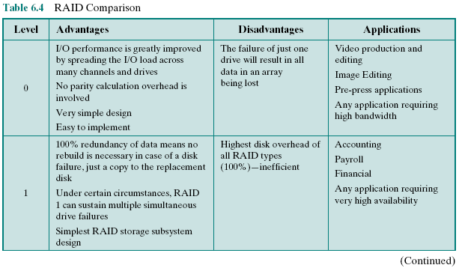
Table 6.4: RAID Comparison (page 1 of 2)
Notes:
Table 6.4 is a comparative summary of the seven levels.

Slide 33
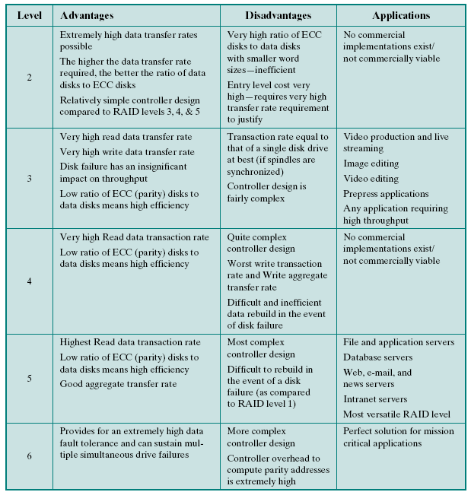
Table 6.4
RAID Comparison (page 2 of 2)
Notes:
Table 6.4 RAID comparison (page 2 of 2)

Slide 34
6.3-Solid State Drive (SSD)
A memory device made with solid state components that can be used as a replacement to a hard disk drive (HDD)
Flash memory
Two distinctive types of flash memory:
A type of semiconductor memory used in many consumer electronic products including smart phones, GPS devices, MP3 players, digital cameras, and USB devices
NOR
The basic unit of access is a bit
Provides high-speed random access
Used to store cell phone operating system code and on Windows computers for the BIOS program that runs at start-up
The term solid state refers to electronic circuitry built with semiconductors
NAND
The basic unit is 16 or 32 bits
Reads and writes in small blocks
Used in USB flash drives, memory cards, and in SSDs
Does not provide a random-access external address bus so the data must be read on a block-wise basis
Cost and performance has evolved to the point where it is feasible to use to replace HDDs
Notes:
One of the most significant developments in computer architecture in recent years
is the increasing use of solid state drives (SSDs) to complement or even replace
hard disk drives (HDDs), both as internal and external secondary memory. The
term solid state refers to electronic circuitry built with semiconductors. A solid state
drive is a memory device made with solid state components that can be used as a
replacement to a hard disk drive. The SSDs now on the market and coming on line
use a type of semiconductor memory referred to as flash memory. In this section,
we first provide an introduction to flash memory, and then look at its use in SSDs.
Flash memory is a type of semiconductor memory that has been around for a number
of years and is used in many consumer electronic products, including smart
phones, GPS devices, MP3 players, digital cameras, and USB devices. In recent
years, the cost and performance of flash memory has evolved to the point where it is
feasible to use flash memory drives to replace HDDs.
There are two distinctive types of flash memory, designated as NOR and
NAND. In NOR flash memory, the basic unit of access is a bit, and the logical
organization resembles a NOR logic device. For NAND flash memory, the basic
unit is 16 or 32 bits, and the logical organization resembles NAND devices.
NOR flash memory provides high-speed random access. It can read and
write data to specific locations, and can reference and retrieve a single byte. NOR
flash memory is used to store cell phone operating system code and on Windows
computers for the BIOS program that runs at startup. NAND reads and writes in
small blocks. It is used in USB flash drives, memory cards (in digital cameras, MP3
players, etc.), and in SSDs. NAND provides higher bit density than NOR and greater
write speed. NAND flash does not provide a random-access external address bus so
the data must be read on a block-wise basis (also known as page access), where each
block holds hundreds to thousands of bits.

Slide 35
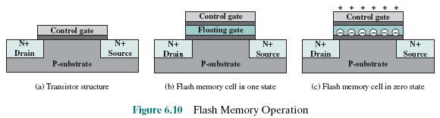
Flash Memory Operation
(a) In transistors, a small voltage applied to the control gate can be used to control the flow of a large current between the source and the drain (ống dẫn).
(b) In a flash memory cell, a second gate(floating gate, insulated by a thin oxide layer) is added to the transistor. Initially, the floating gate does not interfere with the operation of the transistor .
(c) Applying a large voltage across the oxide layer causes electrons to tunnel through it and become trapped on the floating gate, where they remain even if the power is disconnected.

Slide 36
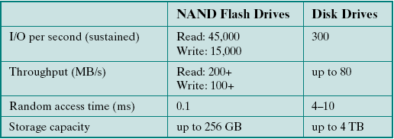
SSD Compared to HDD
Table
6.5
SSDs have the following advantages over HDDs:
High-performance input/output operations per second (IOPS)
Durability/ Longer lifespan
Lower power consumption
Quieter and cooler running capabilities
Lower access times and latency rates
Comparisons
Notes:
As the cost of flash-based SSDs has dropped and the performance and bit density
increased, SSDs have become increasingly competitive with HDDs. Table 6.5 shows
typical measures of comparison at the time of this writing.
SSDs have the following advantages over HDDs:
• High-performance input/output operations per second (IOPS): Significantly
increases performance I/O subsystems.
• Durability: Less susceptible to physical shock and vibration.
• Longer lifespan: SSDs are not susceptible to mechanical wear.
• Lower power consumption: SSDs use as little as 2.1 watts of power per drive,
considerably less than comparable-size HDDs.
• Quieter and cooler running capabilities: Less floor space required, lower
energy costs, and a greener enterprise.
• Lower access times and latency rates: Over 10 times faster than the spinning
disks in an HDD.
Currently, HDDs enjoy a cost per bit advantage and a capacity advantage, but
these differences are shrinking.

Slide 37
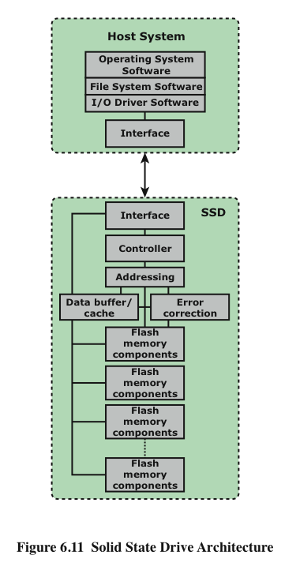
SSD Organization
Notes:
Figure 6.11 illustrates a general view of the common architectural system component
associated with any SDD system. On the host system, to operating system invokes
file system software to access data on the disk. The file system, in turn, invokes I/O
driver software. The I/O driver software provides host access to the particular SSD
product. The interface component in Figure 6.11 refers to the physical and electrical
interface between the host processor and the SSD peripheral device. If the device is
an internal hard drive, a common interface is PCIe. For external devices, one common
interface is USB.
In addition to the interface to the host system, the SSD contains the following
components:
• Controller: Provides SSD device level interfacing and firmware execution.
• Addressing: Logic that performs the selection function across the flash
memory components.
• Data buffer/cache: High speed RAM memory components used for speed
matching and to increased data throughput.
• Error correction: Logic for error detection and correction.
• Flash memory components: Individual NAND flash chips.

Slide 38
Practical Issues
There are two practical issues peculiar to SSDs that are not faced by HDDs:
Flash memory becomes unusable after a certain number of writes
Techniques for prolonging life:
Front-ending the flash with a cache to delay and group write operations
Using wear-leveling algorithms that evenly distribute writes across block of cells
Bad-block management techniques
Most flash devices estimate their own remaining lifetimes so systems can anticipate failure and take preemptive action
SDD performance has a tendency to slow down as the device is used
The entire block must be read from the flash memory and placed in a RAM buffer
Before the block can be written back to flash memory, the entire block of flash memory must be erased
The entire block from the buffer is now written back to the flash memory
Notes:
There are two practical issues peculiar to SSDs that are not faced by HDDs. First,
SDD performance has a tendency to slow down as the device is used. To understand
the reason for this, you need to know that files are stored on disk as a set of pages,
typically 4 KB in length. These pages are not necessarily, and indeed not typically,
stored as a contiguous set of pages on the disk. The reason for this arrangement is
explained in our discussion of virtual memory in Chapter 8. However, flash memory
is accessed in blocks, with a typically block size of 512 KB, so that there are typically
128 pages per block. Now consider what must be done to write a page onto a flash
memory.
1. The entire block must be read from the flash memory and placed in a RAM
buffer. Then the appropriate page in the RAM buffer is updated.
2. Before the block can be written back to flash memory, the entire block of flash
memory must be erased—it is not possible to erase just one page of the flash
memory.
3. The entire block from the buffer is now written back to the flash memory.
Now, when a flash drive is relatively empty and a new file is created, the
pages of that file are written on to the drive contiguously, so that one or only a few
blocks are affected. However, over time, because of the way virtual memory works,
files become fragmented, with pages scattered over multiple blocks. As the drive
become more occupied, there is more fragmentation, so the writing of a new file can
affect multiple blocks. Thus, the writing of multiple pages from one block becomes
slower, the more fully occupied the disk is. Manufacturers have developed a variety
of techniques to compensate for this property of flash memory, such as setting aside
a substantial portion of the SSD as extra space for write operations (called over provisioning),
then to erase inactive pages during idle time used to defragment the
disk. Another technique is the TRIM command, which allows an operating system
to inform a solid state drive (SSD) which blocks of data are no longer considered in
use and can be wiped internally.
A second practical issue with flash memory drives is that a flash memory
becomes unusable after a certain number of writes. As flash cells are stressed,
they lose their ability to record and retain values. A typical limit is 100,000 writes
[GSOE08]. Techniques for prolonging the life of an SSD drive include front-ending
the flash with a cache to delay and group write operations, using wear-leveling algorithms
that evenly distribute writes across block of cells, and sophisticated bad-block
management techniques. In addition, vendors are deploying SSDs in RAID configurations
to further reduce the probability of data loss. Most flash devices are also
capable of estimating their own remaining lifetimes so systems can anticipate failure
and take preemptive action.

Slide 39

6.4- Optical Memory Compact Disk Read-Only Memory
Audio CD and the CD-ROM share a similar technology
The main difference is that CD-ROM players are more rugged and have error correction devices to ensure that data are properly transferred
Production:
The disk is formed from a resin (nhựa nhân tạo) such as polycarbonate
Digitally recorded information is imprinted as a series of microscopic pits (hố) on the surface of the polycarbonate. This is done with a finely focused, high intensity laser to create a master disk
The master is used, in turn, to make a die to stamp out copies onto polycarbonate
The pitted surface is then coated with a highly reflective surface, usually aluminum or gold
This shiny surface is protected against dust and scratches by a top coat of clear acrylic
Finally a label can be silkscreened onto the acrylic

Slide 40
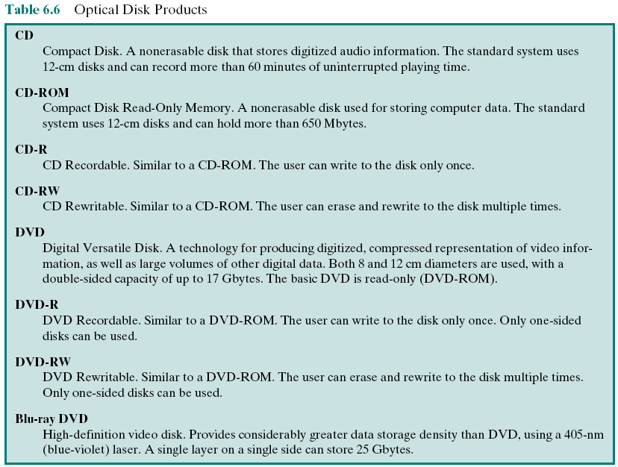
Table 6. 6: Optical Disk Products
Notes:
In 1983, one of the most successful consumer products of all time was introduced:
the compact disk (CD) digital audio system. The CD is a non-erasable disk that can
store more than 60 minutes of audio information on one side. The huge commercial
success of the CD enabled the development of low-cost optical-disk storage
technology that has revolutionized computer data storage. A variety of optical-disk
systems have been introduced (Table 6.6). We briefly review each of these.

Slide 41
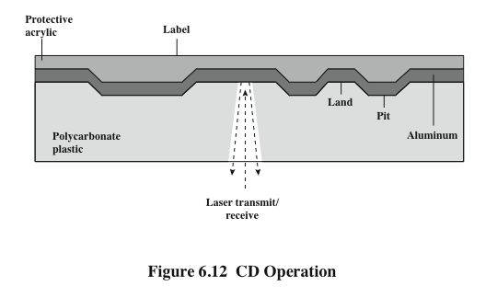
CD Operation
Notes:
Information is retrieved from a CD or CD-ROM by a low-powered laser
housed in an optical-disk player, or drive unit. The laser shines through the clear
polycarbonate while a motor spins the disk past it (Figure 6.12). The intensity of
the reflected light of the laser changes as it encounters a pit. Specifically, if the laser
beam falls on a pit, which has a somewhat rough surface, the light scatters and a low
intensity is reflected back to the source. The areas between pits are called lands.
A land is a smooth surface, which reflects back at higher intensity. The change
between pits and lands is detected by a photo sensor and converted into a digital
signal. The sensor tests the surface at regular intervals. The beginning or end of
a pit represents a 1; when no change in elevation occurs between intervals, a 0 is
recorded.
Recall that on a magnetic disk, information is recorded in concentric tracks.
With the simplest constant angular velocity (CAV) system, the number of bits per
track is constant. An increase in density is achieved with multiple zoned recording,
in which the surface is divided into a number of zones, with zones farther from the
center containing more bits than zones closer to the center. Although this technique
increases capacity, it is still not optimal.
To achieve greater capacity, CDs and CD-ROMs do not organize information
on concentric tracks. Instead, the disk contains a single spiral track, beginning near
the center and spiraling out to the outer edge of the disk. Sectors near the outside
of the disk are the same length as those near the inside. Thus, information is packed
evenly across the disk in segments of the same size and these are scanned at the
same rate by rotating the disk at a variable speed. The pits are then read by the laser
at a constant linear velocity (CLV). The disk rotates more slowly for accesses near
the outer edge than for those near the center. Thus, the capacity of a track and the
rotational delay both increase for positions nearer the outer edge of the disk. The
data capacity for a CD-ROM is about 680 MB.

Slide 42
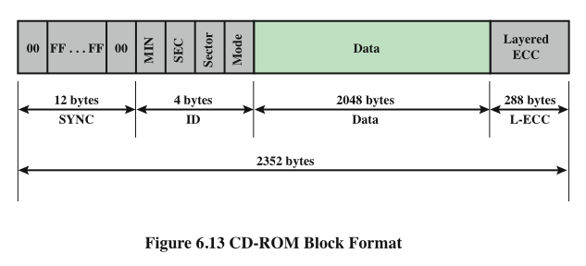
CD-ROM Block Format
Notes:
Data on the CD-ROM are organized as a sequence of blocks. A typical block
format is shown in Figure 6.13. It consists of the following fields:
• Sync: The sync field identifies the beginning of a block. It consists of a byte of
all 0s, 10 bytes of all 1s, and a byte of all 0s.
• Header: The header contains the block address and the mode byte. Mode
0 specifies a blank data field; mode 1 specifies the use of an error-correcting
code and 2048 bytes of data; mode 2 specifies 2336 bytes of user data with no
error-correcting code.
• Data: User data.
• Auxiliary: Additional user data in mode 2. In mode 1, this is a 288-byte error correcting
code.
With the use of CLV, random access becomes more difficult. Locating a specific
address involves moving the head to the general area, adjusting the rotation
speed and reading the address, and then making minor adjustments to find and
access the specific sector.

Slide 43


CD-ROM
CD-ROM is appropriate for the distribution of large amounts of data to a large number of users
Because the expense of the initial writing process it is not appropriate for individualized applications
The CD-ROM has two advantages:
The optical disk together with the information stored on it can be mass replicated inexpensively
The optical disk is removable, allowing the disk itself to be used for archival storage
The CD-ROM disadvantages:
It is read-only and cannot be updated
It has an access time much longer than that of a magnetic disk drive
Notes:
CD-ROM is appropriate for the distribution of large amounts of data to a
large number of users. Because of the expense of the initial writing process, it is not
appropriate for individualized applications. Compared with traditional magnetic
disks, the CD-ROM has two advantages:
• The optical disk together with the information stored on it can be mass replicated
inexpensively—unlike a magnetic disk. The database on a magnetic disk
has to be reproduced by copying one disk at a time using two disk drives.
• The optical disk is removable, allowing the disk itself to be used for archival
storage. Most magnetic disks are non-removable. The information on non-removable
magnetic disks must first be copied to another storage medium
before the disk drive/disk can be used to store new information.
The disadvantages of CD-ROM are as follows:
• It is read-only and cannot be updated.
• It has an access time much longer than that of a magnetic disk drive, as much
as half a second.

Slide 44
CD Recordable CD Rewritable (CD-R) (CD-RW)
Write-once read-many
Accommodates applications in which only one or a small number of copies of a set of data is needed
Disk is prepared in such a way that it can be subsequently written once with a laser beam of modest-intensity
Medium includes a dye (thuốc nhuộm) layer which is used to change reflectivity and is activated by a high-intensity laser
Provides a permanent record of large volumes of user data
Can be repeatedly written and overwritten
Phase change disk uses a material that has two significantly different reflectivities in two different phase states
Amorphous (vô định hình)state: Molecules exhibit a random orientation that reflects light poorly
Crystalline state: Has a smooth surface that reflects light well
A beam of laser light can change the material from one phase to the other
Disadvantage is that the material eventually and permanently loses its desirable properties
Advantage is that it can be rewritten
Notes:
To accommodate applications in which only one or a small
number of copies of a set of data is needed, the write-once read-many CD, known
as the CD recordable (CD-R), has been developed. For CD-R, a disk is prepared
in such a way that it can be subsequently written once with a laser beam of
modest -intensity. Thus, with a some what more expensive disk controller than for
CD-ROM, the customer can write once as well as read the disk.
The CD-R medium is similar to but not identical to that of a CD or
CD-ROM. For CDs and CD-ROMs, information is recorded by the pitting of
the surface of the medium, which changes reflectivity. For a CD-R, the medium
includes a dye layer. The dye is used to change reflectivity and is activated
by a high-intensity laser. The resulting disk can be read on a CD-R drive or a
CD-ROM drive.
The CD-R optical disk is attractive for archival storage of documents and files.
It provides a permanent record of large volumes of user data.
The CD-RW optical disk can be repeatedly written and
overwritten, as with a magnetic disk. Although a number of approaches have been
tried, the only pure optical approach that has proved attractive is called phase
change. The phase change disk uses a material that has two significantly different
reflectivities in two different phase states. There is an amorphous state, in which the
molecules exhibit a random orientation that reflects light poorly; and a crystalline
state, which has a smooth surface that reflects light well. A beam of laser light can
change the material from one phase to the other. The primary disadvantage of
phase change optical disks is that the material eventually and permanently loses
its desirable properties. Current materials can be used for between 500,000 and
1,000,000 erase cycles.
The CD-RW has the obvious advantage over CD-ROM and CD-R that it can
be rewritten and thus used as a true secondary storage. As such, it competes with
magnetic disk. A key advantage of the optical disk is that the engineering tolerances
for optical disks are much less severe than for high-capacity magnetic disks. Thus,
they exhibit higher reliability and longer life.

Slide 45
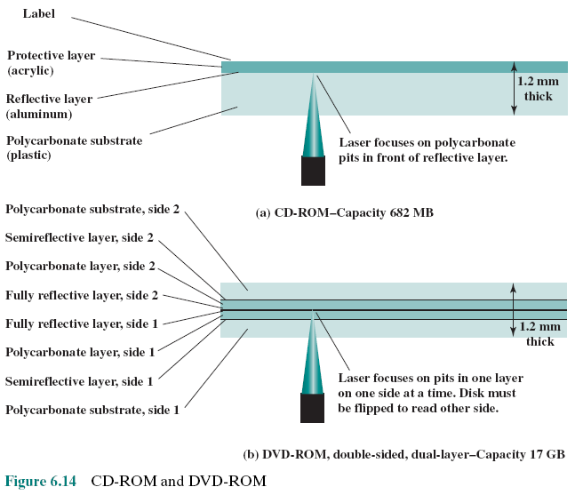

Digital Versatile Disk (DVD) Đĩa Đa năng Số
Notes:
With the capacious digital versatile disk (DVD), the electronics industry has at last
found an acceptable replacement for the analog VHS video tape. The DVD has
replaced the videotape used in video cassette recorders (VCRs) and, more important
for this discussion, replace the CD-ROM in personal computers and servers.
The DVD takes video into the digital age. It delivers movies with impressive picture
quality, and it can be randomly accessed like audio CDs, which DVD machines
can also play. Vast volumes of data can be crammed onto the disk, currently seven
times as much as a CD-ROM. With DVD’s huge storage capacity and vivid quality,
PC games have become more realistic and educational software incorporates more
video. Following in the wake of these developments has been a new crest of traffic
over the Internet and corporate intranets, as this material is incorporated into
Web sites.
The DVD’s greater capacity is due to three differences from CDs (Figure 6.14):
1. Bits are packed more closely on a DVD. The spacing between loops of a spiral on a
CD is 1.6 μm and the minimum distance between pits (hố) along the spiral is 0.834 μm.
The DVD uses a laser with shorter wavelength and achieves a loop spacing of
0.74 μm and a minimum distance between pits of 0.4 μm. The result of these
two improvements is about a seven-fold increase in capacity, to about 4.7 GB.
2. The DVD employs a second layer of pits and lands on top of the first layer. A
dual-layer DVD has a semi-reflective layer on top of the reflective layer, and
by adjusting focus, the lasers in DVD drives can read each layer separately.
This technique almost doubles the capacity of the disk, to about 8.5 GB. The
lower reflectivity of the second layer limits its storage capacity so that a full
doubling is not achieved.
3. The DVD-ROM can be two sided, whereas data are recorded on only one side
of a CD. This brings total capacity up to 17 GB.

Slide 46
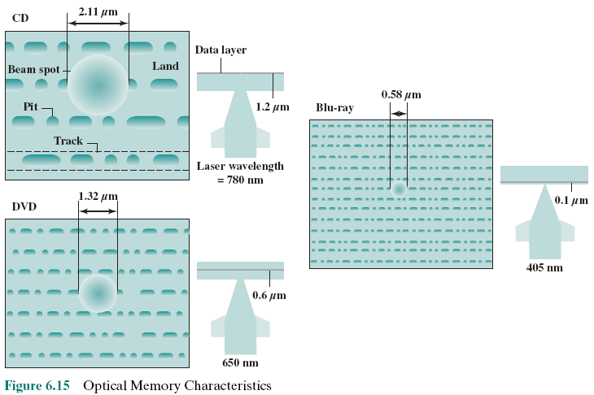
High-Definition (HD) Optical Disks
CD: 700MB/single side
DVD: 4.7GB/single layer/single side
HD DVD: 15 GB/single layer/single side
Blu-ray: 25GB/single layer/single side
Notes:
High-definition optical disks are designed to store high-definition videos and to
provide significantly greater storage capacity compared to DVDs. The higher bit
density is achieved by using a laser with a shorter wavelength, in the blue-violet
range. The data pits, which constitute the digital 1s and 0s, are smaller on the high-definition
optical disks compared to DVD because of the shorter laser wavelength.
Two competing disk formats and technologies initially competed for market
acceptance: HD DVD and Blu-ray DVD. The Blu-ray scheme ultimately achieved
market dominance. The HD DVD scheme can store 15 GB on a single layer on a
single side. Blu-ray positions the data layer on the disk closer to the laser (shown on
the right-hand side of each diagram in Figure 6.15). This enables a tighter focus and
less distortion and thus smaller pits and tracks. Blu-ray can store 25 GB on a single
layer. Three versions are available: read only (BD-ROM), recordable once (BD-R),
and re-recordable (BD-RE).

Slide 47
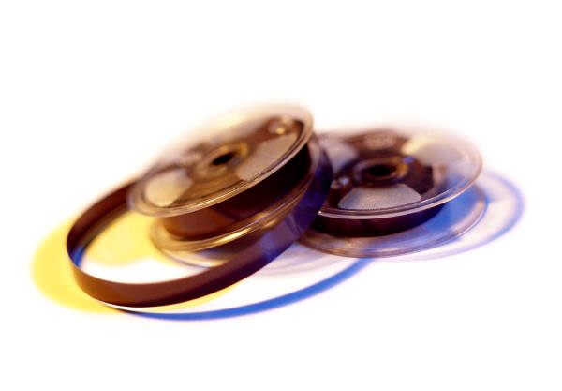
6.5- Magnetic Tape
Tape systems use the same reading and recording techniques as disk systems
Medium is flexible polyester tape coated with magnetizable material
Coating may consist of particles of pure metal in special binders or vapor-plated metal films
Data on the tape are structured as a number of parallel tracks running lengthwise
Serial recording
Data are laid out as a sequence of bits along each track
Data are read and written in contiguous blocks called physical records
Blocks on the tape are separated by gaps referred to as inter-record gaps
Notes:
Tape systems use the same reading and recording techniques as disk systems. The
medium is flexible polyester (similar to that used in some clothing) tape coated with
magnetizable material. The coating may consist of particles of pure metal in special
binders or vapor-plated metal films. The tape and the tape drive are analogous
to a home tape recorder system. Tape widths vary from 0.38 cm (0.15 inch) to
1.27 cm (0.5 inch). Tapes used to be packaged as open reels that have to be threaded
through a second spindle for use. Today, virtually all tapes are housed in cartridges.
Data on the tape are structured as a number of parallel tracks running lengthwise.
Earlier tape systems typically used nine tracks. This made it possible to store
data one byte at a time, with an additional parity bit as the ninth track. This was
followed by tape systems using 18 or 36 tracks, corresponding to a digital word or
double word. The recording of data in this form is referred to as parallel recording.
Most modern systems instead use serial recording, in which data are laid out as a
sequence of bits along each track, as is done with magnetic disks. As with the disk,
data are read and written in contiguous blocks, called physical records, on a tape.
Blocks on the tape are separated by gaps referred to as inter-record gaps. As with the
disk, the tape is formatted to assist in locating physical records.

Slide 48
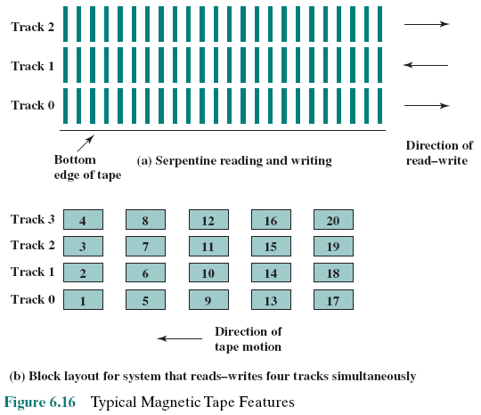

Magnetic Tape Features
Notes:
The typical recording technique used in serial tapes is referred to as serpentine
(dạng xoắn) recording. In this technique, when data are being recorded, the first set of bits is
recorded along the whole length of the tape. When the end of the tape is reached,
the heads are repositioned to record a new track, and the tape is again recorded on
its whole length, this time in the opposite direction. That process continues, back
and forth, until the tape is full (Figure 6.16a). To increase speed, the read-write
head is capable of reading and writing a number of adjacent tracks simultaneously
(typically two to eight tracks). Data are still recorded serially along individual tracks,
but blocks in sequence are stored on adjacent tracks, as suggested by Figure 6.16b.
A tape drive is a sequential-access device. If the tape head is positioned at
record 1, then to read record N, it is necessary to read physical records 1 through
N - 1, one at a time. If the head is currently positioned beyond the desired record, it
is necessary to rewind the tape a certain distance and begin reading forward. Unlike
the disk, the tape is in motion only during a read or write operation.
In contrast to the tape, the disk drive is referred to as a direct-access device. A
disk drive need not read all the sectors on a disk sequentially to get to the desired
one. It must only wait for the intervening sectors within one track and can make successive
accesses to any track.
Magnetic tape was the first kind of secondary memory. It is still widely used as
the lowest-cost, slowest-speed member of the memory hierarchy.

Slide 49
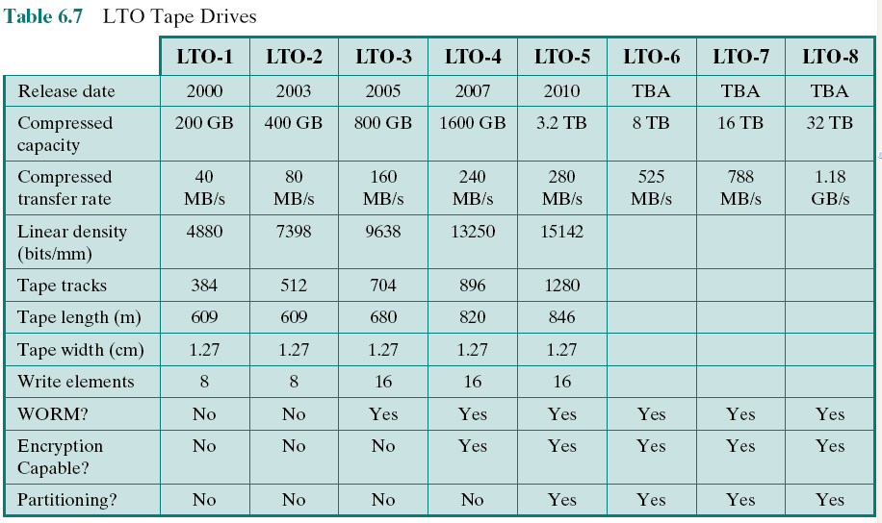
Table 6.7: LTO Tape Drives
Linear tape-open (LTO)
Notes:
The dominant tape technology today is a cartridge system known as linear
tape-open (LTO). LTO was developed in the late 1990s as an open-source alternative
to the various proprietary systems on the market. Table 6.7 shows parameters
for the various LTO generations. See Appendix J for details.

Slide 50
Exercises
6.1 What are the advantages of using a glass substrate for a magnetic disk?
6.2 How are data written onto a magnetic disk?
6.3 How are data read from a magnetic disk?
6.4 Explain the difference between a simple CAV system and a multiple zoned recording system.
6.5 Define the terms track, cylinder, and sector.
6.6 What is the typical disk sector size?

Slide 51
Exercises
6.7 Define the terms seek time, rotational delay, access time, and transfer time.
6.8 What common characteristics are shared by all RAID levels?
6.9 Briefly define the seven RAID levels.
6.10 Explain the term striped data.
6.11 How is redundancy achieved in a RAID system?
6.12 In the context of RAID, what is the distinction between parallel access and independent access?

Slide 52
Summary
External Memory
Chapter 6
RAID
RAID level 0
RAID level 1
RAID level 2
RAID level 3
RAID level 4
RAID level 5
RAID level 6
Optical memory
Compact disk
Digital versatile disk
High-definition optical disks
Magnetic disk
Magnetic read and write mechanisms
Data organization and formatting
Physical characteristics
Disk performance parameters
Solid state drives
Flash memory
SSD compared to HDD
SSD organization
Practical issues
Magnetic tape
Notes:
Chapter 6 summary.

